Slide 1
Hack-a-thon for good

Slide 2
The event

Slide 3
Amanda and the issue

Slide 4
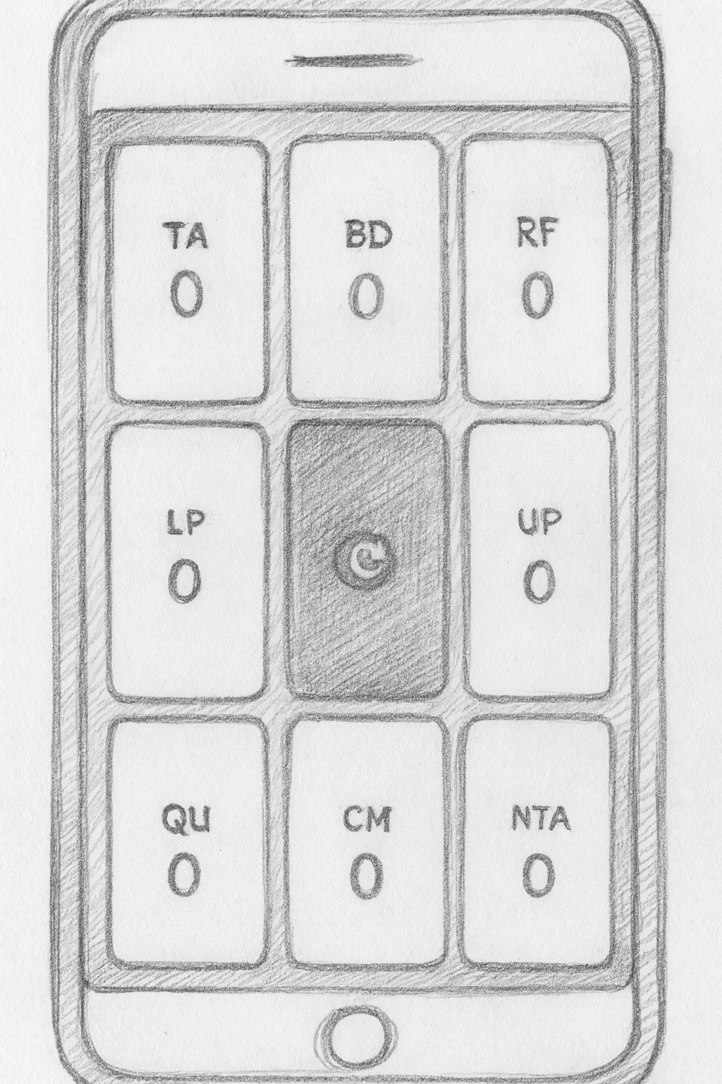
The Solution

Slide 5
concept
Markdown as code

Slide 6
Project Description This is an app to count that lets you press 8 buttons to count in 8 categories Technologies Single-page app with no backend that runs completely on the frontend in JS/TS. It's designed to run on a phone. Main Page 9 buttons in a grid 1 2 3 4 5 6 7 8 9 All buttons except for the configuration contain a count Button Descriptions
LP (labeled praise)
RF (reflect kid)
BD (behavior description)
TA (talk)
Config
UP (unlabeled praise)
NTA (criticism)
QU (question)
CA (command) The config button is slightly smaller than the others.
Config Button The config button will pop up a screen on top of the screen with other less used buttons. The four buttons are:
return
undo last action
cancel evaluation
finish evaluation When you hit finish evaluation, it gives you a list of the numbers next to the labels (counts). Serving To serve this local, we will use some technology (Claude please fill this in and draw my attention to you doing it) To serve it globally, it will be a github pages
The Markdown File

Slide 7
> Read docs/project_description.md and ask me what's not clear from it and address questions in the doc

Slide 8
